Slide 1
Introduction to Arrays

Slide 2
Arrays
Definition: A group of variables or constants, all of the same type, referred to by a single name.
An individual value within the array is called an array element.
Identified by the array name and a subscript pointing to the particular location within the array.
Each element is a variable just like any other.
The subscript is always of type integer.
Can be manipulated:
Element by element
As a whole
As a subset.

Slide 3
Declaring Arrays
REAL, DIMENSION(16) :: voltage
Alternatively:
REAL :: voltage(16)
The DIMENSION attribute declares the size of the array.
Arrays may be declared with more than one subscript.
Rank - The number of subscripts declared.
Extent - The number of elements in a given dimension.
Shape - defined as the combination of its rank and extent in each dimension.
Size - total number of elements.

Slide 4
Array Constants
Array constant - array consisting entirely of constants.
Defined by placing the constant values between array constructors:
Examples:
FORTRAN 1995 - (/ 1, 2, 3, 4, 5 /)
FORTRAN 2003 - [ 1, 2, 3, 4, 5 ]

Slide 5
Array Initialization
Array elements should never be used until they are initialized.
Three ways to initialize:
Assignment statements.
Type declaration statements.
Using the READ statement.

Slide 6
Assignment Statement Initialization
Element by Element:
REAL, DIMENSION(10) :: array1
DO I= 1, 10
array1(I) = REALvar(I)
END DO
All at once using an array constructor:
REAL, DIMENSION(10) :: array1
array1 = [1.,2.,3.,4.,5.,6.,7.,8.,9,.10.]
Initialization of all elements using a single value:
REAL, DIMENSION(10) :: array1
array1 = 0.0

Slide 7
Type Declaration Initialization
Initialize using an array constructor:
REAL, DIMENSION(5) :: array2 = [ 1,2,3,4,5]
Using an implied DO loop.
REAL, DIMENSION(5) :: array2 = [ i, i = 1, 5 ]
An implied DO loop has the general form:
(arg1, arg2, …, index = istart, iend, incr)
Implied DO loops may be nested or mixed:
REAL, DIMENSION(25) :: array2 = [((0, i=1,4),5*j, j=1,5)]
Initialized to a single constant:
REAL, DIMENSION(5) :: array2 = 1.0

Slide 8
Changing the Subscript Range
Elements normally addressed using subscripts:
Example:
REAL, DIMENSION(5) :: alt
Elements addressed as:
alt(1), alt(2), alt(3), …
What if you wanted to address these elements over a different range
It is possible to specify the range on numbers that will be used to address the elements of an array:
REAL, DIMENSION(lower_bound : upper_bound) :: alt
Examples:
REAL, DIMENSION(5) :: A1
REAL, DIMENSION(-2:2) ::B1
REAL, DIMENSION(5:9) :: C1
Note: All of these examples have the same shape
The extent of the any given dimension can be determined:
Extent = upper_bound – lower_bound + 1

Slide 9
Out of Bounds Array Subscripts
Integers that can be used to address array elements depends on the extent of the array.
REAL, DIMENSION(5) :: alt
Integer subscripts 1 – 5 address the elements of the array
Out of bounds integer is invalid since it doesn’t correspond to allocated memory locations.
A program can still run with a bounds error.
Compilers can help find these errors.
Turn on bounds checking during debugging.
Turn off bounds checking to speed up the execution.

Slide 10
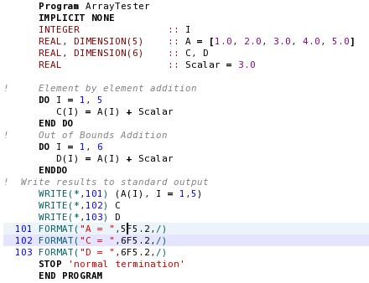
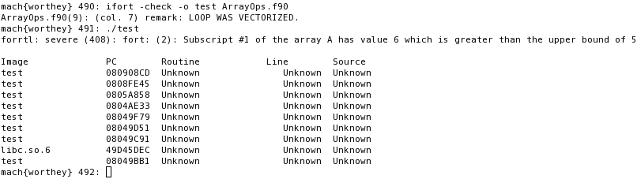
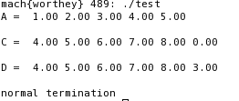

Array Bounds Example

Slide 11
Named Constants
It’s good practice to declare array sizes using named constants
Example:
INTEGER, PARAMETER :: MaxSize = 1000
REAL :: array1(MaxSize)
REAL :: array2(MaxSize)
REAL :: array3(2*MaxSize)
Name constants make it easy to resize arrays.

Slide 12
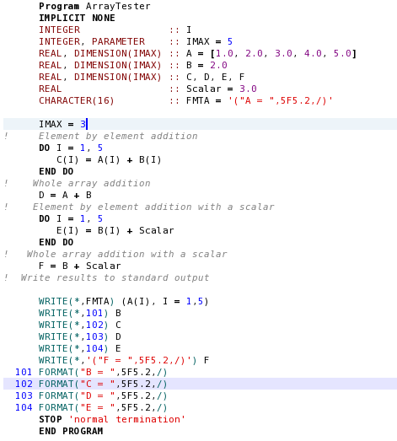

PARAMETER Example:

Slide 13
Whole Array Operations
Whole arrays may be used in arithmetic Calculations
They must be conformable (have the same shape)
Do not have to have the same subscript range.
Operations are applied on an element by element basis.
Scalar values are also conformable.
Many 95/2003 intrinsic functions accept arrays
Some functions accept array as arguments as well as scalars.
Referred to as elemental intrinsic functions.
Examples include ABS, SIN, COS, etc.
A complete list is presented in Appendix B
Function is applied on an element by element basis

Slide 14
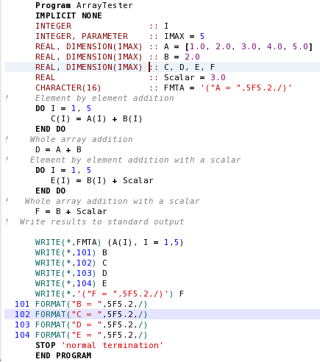
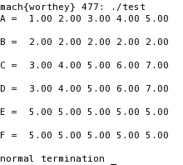
Whole Array Example:

Slide 15
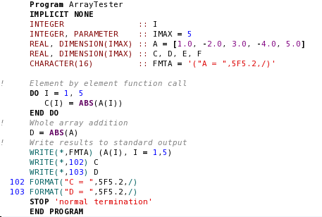
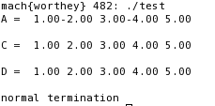
Intrinsic Function Example:

Slide 16
Array Subsets
A subset of an Array is a Array Section.
Specified by replacing the array subscript with either a:
Subscript triplet:
General form - subscript_1 : subscript_2 : stride
Example:
INTERGER, DIMENSION(10) :: array = (/1,2,3,4,5,6,7,8,9,10/)
Array Subset array(1:10:2) contains only elements array(1), array(3), array(5), array(7), and array(9).
Vector subscript:
A vector subscript is a one-dimensional integer array specifying the array elements to be used in a calculation.
Example:
INTEGER, DIMENSION(5) :: vec = ( 1, 6, 4, 1, 9 /)
REAL, DIMENSION(10) :: a = (/ 1., -2., 3., -4., 5., -6., 7., -8., 9., -10. /)
The array subset a(vec) would be [ 1., -6., -4., 1., 9.]

Slide 17
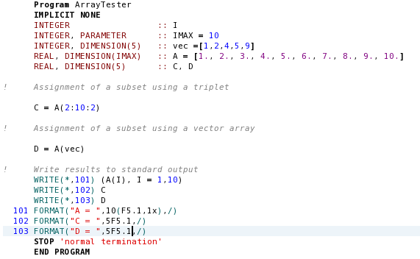
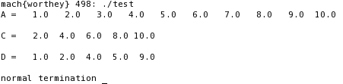
Array Subscript Examples:

Slide 18
Input and Output
Input / output of array elements
Array elements can be used in input /output statements just like any other variable
Example:
WRITE(*,100) a(1), a(2), a(3), a(4), a(5)
100 FORMAT (1X, ‘a =‘, 5F10.2)
The implied DO loop
Simple example:
WRITE(*,100) (a(i), i =1, 5)
General Form:
WRITE(unit, format) (arg1, arg2, …, index= istart, iend, incr)
Nested implied DO loop example:
WRITE(*,100) ((i, j, j = 1,3),i = 1,2)

Slide 19
Whole Array Example:

Slide 20
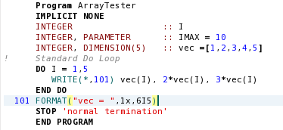

I/O Differences - Standard DO Loop

Slide 21
The Standard DO Loop Equivalent
The WRITE Statement is executed 5 times
WRITE(*, 1000) arr(1), 2*arr(1), 3*arr(1)
WRITE(*, 1000) arr(2), 2*arr(2), 3*arr(2)
WRITE(*, 1000) arr(3), 2*arr(3), 3*arr(3)
WRITE(*, 1000) arr(4), 2*arr(4), 3*arr(4)
WRITE(*, 1000) arr(5), 2*arr(5), 3*arr(5)

Slide 22
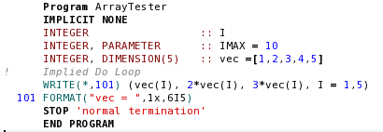

I/O Differences - Implied DO Loop

Slide 23
The Implied DO Equivalent
This single write has 15 arguments
WRITE(*, 1000) arr(1), 2*arr(1), 3*arr(1), &
arr(2), 2*arr(2), 3*arr(2), &
arr(3), 2*arr(3), 3*arr(3), &
arr(4), 2*arr(4), 3*arr(4), &
arr(5), 2*arr(5), 3*arr(5)

Slide 24
Program Test - Output
Standard DO Loop Output
1 2 3
2 4 6
3 6 9
4 8 12
5 10 15
1 2 3 2 4 6
3 6 9 4 8 12
5 10 15
The main difference between these two approaches is the behavior with the associated format.
Remember each WRITE statement starts at the beginning of the format.
Implied DO Loop Output

Slide 25
When Should You Use an Array?
In general, if much or all the input data must be in memory at the same time.
Otherwise arrays are not needed.
Unnecessary arrays waste memory
Arrays can eat up a lot of memory making the program larger than it needs to be.
Unnecessary arrays can restrict program capabilities.

Slide 26
Good Coding Practice
Determine if array is really needed.
Declare all arrays sizes using named constants.
Initialized before use.
Use bounds checking when debugging.

